Slide 1
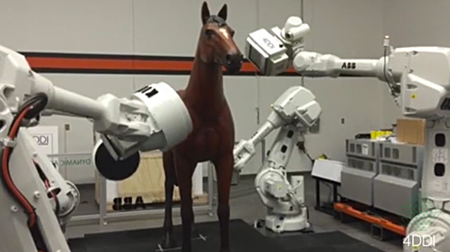
Testing
Note: The SP24 live lecture will be different from what these slides show. Any differences will not be in scope for exams, and serve as examples on how to apply the concepts covered in this lecture.
Here are the videos corresponding to these slides.
Here is the repo corresponding to today's new lecture.
Lecture 6
CS61B, Spring 2024 @ UC Berkeley
Slides credit: Josh Hug

Slide 2
A New Way
A New Way
Intro to Unit Testing
Ad-Hoc Tests are Tedious
Unit Testing Frameworks, Truth
Building Selection Sort
The Selection Sort Algorithm
Find Smallest
Swap
Correcting a Design Error
Figuring out the Recursion
Fixing Another Design Error
Testing Philosophy
Lecture 6, CS61B, Spring 2024

Slide 3
How Does a Programmer Know That Their Code Works?
In prior programming classes, you most likely knew your code worked because it passed some autograder tests or local tests provided by an instructor.
In the real world, programmers believe their code works because of tests they write themselves.
Knowing that your code is completely correct is usually impossible.
But tests can provide strong evidence.
This will be our new way.

Slide 4

How Does a Programmer Know That Their Code Works?
In prior programming classes, you most likely knew your code worked because it passed some autograder tests or local tests provided by an instructor.
In the real world, programmers believe their code works because of tests they write themselves.
Knowing that your code is completely correct is usually impossible.
But tests can provide strong evidence.
This will be our new way.
Notes:
Video source: Wet Hot American Summer

Slide 5
Sorting: The McGuffin for Our Testing Adventure
To try out this new way™, we need a task to complete.
Let’s try to write a method that sorts arrays of Strings.
x = {“he”, “is”, “the”, “agoyatis”, “of”, “mr.”, “conchis”}
public static void sort(String[] x)
x = {“agoyatis”, “conchis”, “he”, “is”, “mr.”, “of”, “the”}
Notes:
4150!

Slide 6
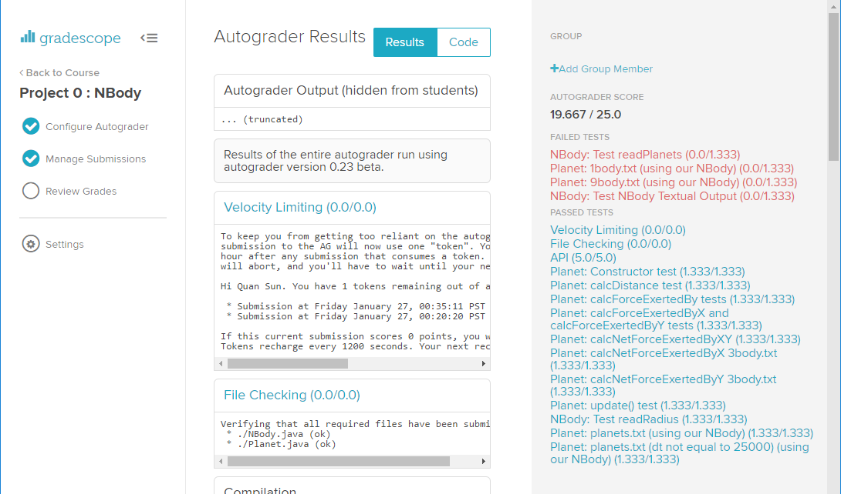
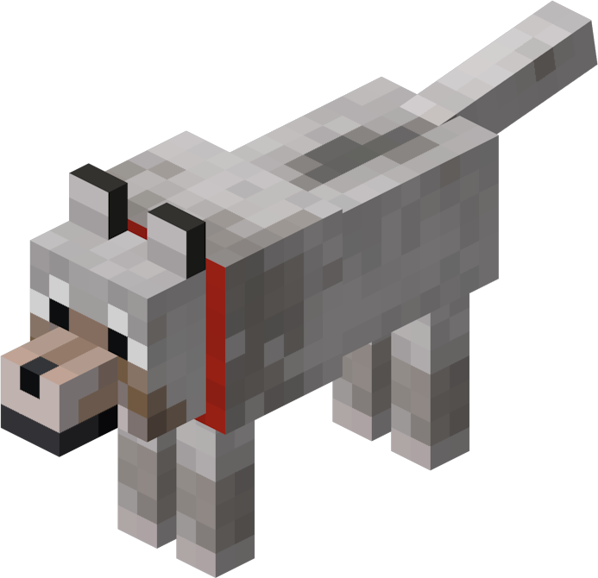
The Old Way
Autograder
public static void sort(String[] x)
Notes:
Minecraft dog

Slide 7
The New Way
In this lecture we’ll write sort, as well as our own test for sort.
Even crazier idea: We’ll start by writing testSort first!
Your Test
void testSort()
public static void sort(String[] x)
Notes:
Minecraft dog

Slide 8
Coding Demo
Sort.java
public class Sort {
public static void sort(String[] x) {
return;
}
}

Slide 9
Ad-Hoc Tests are Tedious
A New Way
Intro to Unit Testing
Ad-Hoc Tests are Tedious
Unit Testing Frameworks, Truth
Building Selection Sort
The Selection Sort Algorithm
Find Smallest
Swap
Correcting a Design Error
Figuring out the Recursion
Fixing Another Design Error
Testing Philosophy
Lecture 6, CS61B, Spring 2024

Slide 10
Writing a Test
If we tried to write a test, the most natural approach would be to start with an input and expected result.
public class TestSort {
/** Tests the sort method of the Sort class. */
public static void testSort() {
String[] input = {"CC", "BB", "DD", "AA"};
String[] expected = {"AA", "BB", "CC", "DD"};
...
}
public static void main(String[] args) {
testSort();
}
}

Slide 11
Writing a Test
If we tried to write a test, the most natural approach would be to start with an input and expected result. Then call sort.
public class TestSort {
/** Tests the sort method of the Sort class. */
public static void testSort() {
String[] input = {"CC", "BB", "DD", "AA"};
String[] expected = {"AA", "BB", "CC", "DD"};
Sort.sort(input);
...
}
public static void main(String[] args) {
testSort();
}
}

Slide 12
Writing a Test
If we tried to write a test, the most natural approach would be to start with an input and expected result. Then call sort. Then compare the actual result with the expected result.
public class TestSort {
/** Tests the sort method of the Sort class. */
public static void testSort() {
String[] input = {"CC", "BB", "DD", "AA"};
String[] expected = {"AA", "BB", "CC", "DD"};
Sort.sort(input);
... // see next slide
}
public static void main(String[] args) {
testSort();
}
}

Slide 13
Comparison Code
The code that compares the input and expected might look something like below:
Details aren’t important, just that it’s long and boring code to write.
String[] input = {"CC", "BB", "DD", "AA"};
String[] expected = {"AA", "BB", "CC", "DD"};
Sort.sort(input);
for (int i = 0; i < input.length; i += 1) {
if (!input[i].equals(expected[i])) {
System.out.println("Mismatch at position " + i +
", expected: '" + expected[i] +
"', but got '" + input[i] + "'");
return;
}
}

Slide 14
Such Ad-Hoc Testing is Tedious and Repetitive
public class TestSort {
/** Tests the sort method of the Sort class. */
public static void testSort() {
String[] input = {"CC" , "BB", "DD", "AA"};
String[] expected = {"AA" , "BB", "CC", "DD"};
Sort.sort(input);
for (int i = 0; i < input.length; i += 1) {
if (!input[i].equals(expected[i])) {
System.out.println("Mismatch at position " + i + ", expected: '" + expected[i] +
"', but got '" + input[i] + "'");
return;
}
}
}
public static void main(String[] args) {
testSort();
}
}
Code similar to this appears in essentially any test. Tedious to write.
Notes:
Minecraft dog

Slide 15
Unit Testing Frameworks, Truth
A New Way
Intro to Unit Testing
Ad-Hoc Tests are Tedious
Unit Testing Frameworks, Truth
Building Selection Sort
The Selection Sort Algorithm
Find Smallest
Swap
Correcting a Design Error
Figuring out the Recursion
Fixing Another Design Error
Testing Philosophy
Lecture 6, CS61B, Spring 2024

Slide 16
Unit Tests
We just wrote a unit test:
Straight from wikipedia: “In computer programming, unit testing is a software testing method by which individual units of source code … are tested to determine whether they are fit for use.”
Unit testing frameworks do the hard work for us.
Example: JUnit (pre-sp23), AssertJ, and Truth (sp23 to present).
Less tedious, even fun.
Let’s try writing a unit test using Truth.

Slide 17
Coding Demo
TestSort.java
public class TestSort {
/** Tests the sort method of the Sort class. */
public static void testSort() {
}
}

Slide 18
Coding Demo
TestSort.java
public class TestSort {
/** Tests the sort method of the Sort class. */
public static void testSort() {
String[] input = {"rawr", "a", "zaza", "newway"};
}
}

Slide 19
Coding Demo
TestSort.java
public class TestSort {
/** Tests the sort method of the Sort class. */
public static void testSort() {
String[] input = {"rawr", "a", "zaza", "newway"};
String[] expected = {"a", "newway", "rawr", "zaza"};
}
}

Slide 20
Coding Demo
TestSort.java
public class TestSort {
/** Tests the sort method of the Sort class. */
public static void testSort() {
String[] input = {"rawr", "a", "zaza", "newway"};
String[] expected = {"a", "newway", "rawr", "zaza"};
Sort.sort(input);
}
}

Slide 21
Coding Demo
TestSort.java
import static com.google.common.truth.Truth.assertThat;
public class TestSort {
/** Tests the sort method of the Sort class. */
public static void testSort() {
String[] input = {"rawr", "a", "zaza", "newway"};
String[] expected = {"a", "newway", "rawr", "zaza"};
Sort.sort(input);
assertThat(input).isEqualTo(expected);
}
}

Slide 22
Coding Demo
TestSort.java
import static com.google.common.truth.Truth.assertThat;
public class TestSort {
/** Tests the sort method of the Sort class. */
public static void testSort() {
String[] input = {"rawr", "a", "zaza", "newway"};
String[] expected = {"a", "newway", "rawr", "zaza"};
Sort.sort(input);
assertThat(input).isEqualTo(expected);
}
public static void main(String[] args) {
testSort();
}
}

Slide 23
Truth: A Library for Making Testing Easier (example below)
import static com.google.common.truth.Truth.assertThat;
public class TestSort {
/** Tests the sort method of the Sort class. */
public static void testSort() {
String[] input = {"cows", "dwell", "above", "clouds"};
String[] expected = {"above", "clouds", "cows", "dwell"};
Sort.sort(input);
assertThat(input).isEqualTo(expected);
}
public static void main(String[] args) {
testSort();
}
}
Notes:
Minecraft dog

Slide 24
Coding Demo
TestSort.java
import static com.google.common.truth.Truth.assertThat;
public class TestSort {
/** Tests the sort method of the Sort class. */
public static void testSort() {
String[] input = {"rawr", "a", "zaza", "newway"};
String[] expected = {"a", "newway", "rawr", "zaza"};
Sort.sort(input);
assertThat(input).isEqualTo(expected);
}
public static void main(String[] args) {
testSort();
}
}

Slide 25
Coding Demo
TestSort.java
import static com.google.common.truth.Truth.assertThat;
import org.junit.jupiter.api.Test;
public class TestSort {
/** Tests the sort method of the Sort class. */
@Test
public static void testSort() {
String[] input = {"rawr", "a", "zaza", "newway"};
String[] expected = {"a", "newway", "rawr", "zaza"};
Sort.sort(input);
assertThat(input).isEqualTo(expected);
}
public static void main(String[] args) {
testSort();
}
}

Slide 26
Coding Demo
TestSort.java
import static com.google.common.truth.Truth.assertThat;
import org.junit.jupiter.api.Test;
public class TestSort {
/** Tests the sort method of the Sort class. */
@Test
public static void testSort() {
String[] input = {"rawr", "a", "zaza", "newway"};
String[] expected = {"a", "newway", "rawr", "zaza"};
Sort.sort(input);
assertThat(input).isEqualTo(expected);
}
}

Slide 27
Coding Demo
TestSort.java
import static com.google.common.truth.Truth.assertThat;
import org.junit.jupiter.api.Test;
public class TestSort {
/** Tests the sort method of the Sort class. */
@Test
public void testSort() {
String[] input = {"rawr", "a", "zaza", "newway"};
String[] expected = {"a", "newway", "rawr", "zaza"};
Sort.sort(input);
assertThat(input).isEqualTo(expected);
}
}

Slide 28
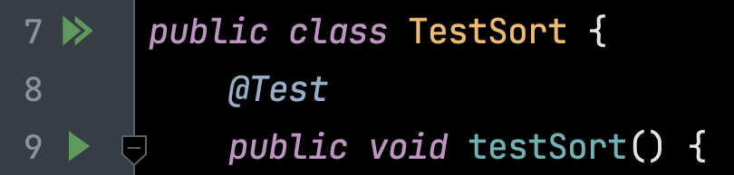
@Test
If we add @Test before a method AND make the function non-static, green arrows appear.
The single green arrow by testSort means “run this function”.
The double green arrow means run all tests in this class.
Why non-static? No idea. IMO, weird.

Slide 29

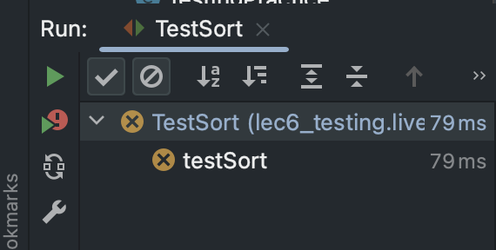
Gamified @Test Output
On added benefit: IntelliJ gamifies bug fixing and design.
Concrete mini-goals.
Progress summarized in bottom left.
You win when you get green checks for every test.
Failed Test

Slide 30
The Selection Sort Algorithm
A New Way
Intro to Unit Testing
Ad-Hoc Tests are Tedious
Unit Testing Frameworks, Truth
Building Selection Sort
The Selection Sort Algorithm
Find Smallest
Swap
Correcting a Design Error
Figuring out the Recursion
Fixing Another Design Error
Testing Philosophy
Lecture 6, CS61B, Spring 2024

Slide 31
Example Sorting Algorithm: Selection Sort
Selection sorting a list of N items:
Find the smallest item.
Move it to the front.
Selection sort the remaining N-1 items (without touching front item!).
Move by swapping the smallest item with the front item.
*
6
3
7
2
8
1
1
3
7
*
2
8
6
1
2
7
*
3
8
6
*
1
2
3
7
8
6
1
2
3
6
8
*
7
1
2
3
6
7
8
As an aside: Can prove correctness of selection sort by thinking about its invariants.
Notes:
20 minutes to get here going slow.

Slide 32
Back to Sorting: Selection Sort
Selection sorting a list of N items:
Find the smallest item.
Move it to the front.
Selection sort the remaining N-1 items (without touching front item!).
Move by swapping the smallest item with the front item.
*
Let’s try implementing this.
I’ll try to simulate as closely as possible how I think students might approach this problem.
Along the way I’ll show how “test driven development” (TDD) helps avoid major problems.
6
3
7
2
8
1
1
3
7
*
2
8
6
1
2
7
*
3
8
6
*
1
2
3
7
8
6
1
2
3
6
8
*
7
1
2
3
6
7
8
Notes:
20 minutes to get here going slow.

Slide 33
Find Smallest
A New Way
Intro to Unit Testing
Ad-Hoc Tests are Tedious
Unit Testing Frameworks, Truth
Building Selection Sort
The Selection Sort Algorithm
Find Smallest
Swap
Correcting a Design Error
Figuring out the Recursion
Fixing Another Design Error
Testing Philosophy
Lecture 6, CS61B, Spring 2024

Slide 34
Selection Sort: Find Smallest
Selection sorting a list of N items:
Find the smallest item (idea: write a findSmallest method).
Move it to the front.
Selection sort the remaining N-1 items (without touching front item!).
*
Let’s try implementing this.
I’ll try to simulate as closely as possible how I think students might approach this problem.
Along the way I’ll show how “test driven development” (TDD) helps avoid major problems.
6
3
7
2
8
1
1
3
7
*
2
8
6
1
2
7
*
3
8
6
*
1
2
3
7
8
6
1
2
3
6
8
*
7
1
2
3
6
7
8
Notes:
20 minutes to get here going slow.

Slide 35
Progress Roadmap
Created testSort:
Created a sort skeleton:
Next up:
Create testFindSmallest:
Create findSmallest:
Code not shown in slides. See lecture video or github.
testSort()
sort(String[] inputs)
testFindSmallest()
String findSmallest(String[] input)
Notes:
20 minutes to get here going slow.

Slide 36
Coding Demo
TestSort.java
public class TestSort {
@Test
public void testFindSmallest() {
}
}

Slide 37
Coding Demo
TestSort.java
public class TestSort {
@Test
public void testFindSmallest() {
String[] input = {"rawr", "a", "zaza", "newway"};
}
}

Slide 38
Coding Demo
TestSort.java
public class TestSort {
@Test
public void testFindSmallest() {
String[] input = {"rawr", "a", "zaza", "newway"};
String expected = "a";
}
}

Slide 39
Coding Demo
TestSort.java
public class TestSort {
@Test
public void testFindSmallest() {
String[] input = {"rawr", "a", "zaza", "newway"};
String expected = "a";
String actual = Sort.findSmallest(input);
}
}

Slide 40
Coding Demo
TestSort.java
public class TestSort {
@Test
public void testFindSmallest() {
String[] input = {"rawr", "a", "zaza", "newway"};
String expected = "a";
String actual = Sort.findSmallest(input);
assertThat(actual).isEqualTo(expected);
}
}

Slide 41
Coding Demo
Sort.java
public class Sort {
public static String findSmallest(String[] x) {
}
}

Slide 42
Coding Demo
Sort.java
public class Sort {
public static String findSmallest(String[] x) {
return "potato";
}
}

Slide 43
Coding Demo
Sort.java
public class Sort {
public static String findSmallest(String[] x) {
String smallest = x[0];
}
}

Slide 44
Coding Demo
Sort.java
public class Sort {
public static String findSmallest(String[] x) {
String smallest = x[0];
for (int i = 0; i < x.length; i += 1) {
}
}
}

Slide 45
Coding Demo
Sort.java
public class Sort {
public static String findSmallest(String[] x) {
String smallest = x[0];
for (int i = 0; i < x.length; i += 1) {
if (x[i] < smallest) {
}
}
}
}

Slide 46
Coding Demo
Sort.java
public class Sort {
public static String findSmallest(String[] x) {
String smallest = x[0];
for (int i = 0; i < x.length; i += 1) {
if (x[i] < smallest) {
smallest = x[i];
}
}
}
}

Slide 47
Coding Demo
Sort.java
public class Sort {
public static String findSmallest(String[] x) {
String smallest = x[0];
for (int i = 0; i < x.length; i += 1) {
if (x[i] < smallest) {
smallest = x[i];
}
}
return smallest;
}
}

Slide 48
Coding Demo
Sort.java
public class Sort {
public static String findSmallest(String[] x) {
String smallest = x[0];
for (int i = 0; i < x.length; i += 1) {
int cmp = x[i].compareTo(smallest);
if (x[i] < smallest) {
smallest = x[i];
}
}
return smallest;
}
}

Slide 49
Coding Demo
Sort.java
public class Sort {
public static String findSmallest(String[] x) {
String smallest = x[0];
for (int i = 0; i < x.length; i += 1) {
int cmp = x[i].compareTo(smallest);
if (cmp < 0) {
smallest = x[i];
}
}
return smallest;
}
}

Slide 50
Coding Demo
Sort.java
public class Sort {
/** @source https://stackoverflow.com/questions/5153496 */
public static String findSmallest(String[] x) {
String smallest = x[0];
for (int i = 0; i < x.length; i += 1) {
int cmp = x[i].compareTo(smallest);
if (cmp < 0) {
smallest = x[i];
}
}
return smallest;
}
}

Slide 51
Progress Roadmap
Created testSort:
Created a sort skeleton:
Created testFindSmallest:
Created findSmallest:
testSort()
Used Google to figure out how to compare strings.
sort(String[] inputs)
testFindSmallest()
String findSmallest(String[] input)
Notes:
20 minutes to get here going slow.

Slide 52
Swap
A New Way
Intro to Unit Testing
Ad-Hoc Tests are Tedious
Unit Testing Frameworks, Truth
Building Selection Sort
The Selection Sort Algorithm
Find Smallest
Swap
Correcting a Design Error
Figuring out the Recursion
Fixing Another Design Error
Testing Philosophy
Lecture 6, CS61B, Spring 2024

Slide 53
Selection Sort: Swap
Selection sorting a list of N items:
Find the smallest item (idea: write a findSmallest method).
Move it to the front (idea: write a swap method).
Selection sort the remaining N-1 items (without touching front item!).
*
Let’s try implementing this.
I’ll try to simulate as closely as possible how I think students might approach this problem.
Along the way I’ll show how “test driven development” (TDD) helps avoid major problems.
6
3
7
2
8
1
1
3
7
*
2
8
6
1
2
7
*
3
8
6
*
1
2
3
7
8
6
1
2
3
6
8
*
7
1
2
3
6
7
8
Notes:
20 minutes to get here going slow.

Slide 54
Progress Roadmap
Created testSort:
Created a sort skeleton:
Created testFindSmallest:
Created findSmallest:
Next up:
testSort()
Used Google to figure out how to compare strings.
sort(String[] inputs)
testFindSmallest()
String findSmallest(String[] input)
Create testSwap:
Create swap:
testSwap()
swap(String[] input, int a, int b)
Notes:
20 minutes to get here going slow.

Slide 55
Coding Demo
TestSort.java
public class TestSort {
@Test
public void testSort() {
String[] input = {"rawr", "a", "zaza", "newway"};
String[] expected = {"a", "newway", "rawr", "zaza"};
Sort.sort(input);
assertThat(input).isEqualTo(expected);
}
}

Slide 56
Coding Demo
TestSort.java
public class TestSort {
@Test
public void testSort() {
String[] input = {"rawr", "a", "zaza", "newway"};
String[] expected = {"a", "newway", "rawr", "zaza"};
Sort.swap(input, 1, 3);
assertThat(input).isEqualTo(expected);
}
}

Slide 57
Coding Demo
TestSort.java
public class TestSort {
@Test
public void testSort() {
String[] input = {"rawr", "a", "zaza", "newway"};
String[] expected = {"rawr", "newway", "zaza", "a"};
Sort.swap(input, 1, 3);
assertThat(input).isEqualTo(expected);
}
}

Slide 58
Coding Demo
Sort.java
public class Sort {
public static void swap(String[] x, int a, int b) {
}
}

Slide 59
Coding Demo
Sort.java
public class Sort {
public static void swap(String[] x, int a, int b) {
x[a] = x[b];
x[b] = x[a];
}
}

Slide 60
Coding Demo
Sort.java
public class Sort {
public static void swap(String[] x, int a, int b) {
String temp = x[a];
x[a] = x[b];
x[b] = temp;
}
}

Slide 61
Correcting a Design Error
A New Way
Intro to Unit Testing
Ad-Hoc Tests are Tedious
Unit Testing Frameworks, Truth
Building Selection Sort
The Selection Sort Algorithm
Find Smallest
Swap
Correcting a Design Error
Figuring out the Recursion
Fixing Another Design Error
Testing Philosophy
Lecture 6, CS61B, Spring 2024

Slide 62
Progress Roadmap
Created testSort:
Created a sort skeleton:
Created testFindSmallest:
Created findSmallest:
Created testSwap:
Created swap:
Now we have all the helper methods we need, as well as tests that give proof that they work! All that’s left is to write the sort method itself.
Let’s start by just doing the first swap as an exploration.
testSort()
Used Google to figure out how to compare strings.
sort(String[] inputs)
testFindSmallest()
String findSmallest(String[] input)
testSwap()
Used debugger to fix.
swap(String[] input, int a, int b)
Notes:
20 minutes to get here going slow.

Slide 63
Coding Demo
Sort.java
public class Sort {
public static void sort(String[] x) {
}
/** @source https://stackoverflow.com/questions/5153496 */
public static String findSmallest(String[] x) {
String smallest = x[0];
for (int i = 0; i < x.length; i += 1) {
int cmp = x[i].compareTo(smallest);
if (cmp < 0) {
smallest = x[i];
}
}
return smallest;
}
}

Slide 64
Coding Demo
Sort.java
public class Sort {
public static void sort(String[] x) {
String smallest = findSmallest(x);
}
/** @source https://stackoverflow.com/questions/5153496 */
public static String findSmallest(String[] x) {
String smallest = x[0];
for (int i = 0; i < x.length; i += 1) {
int cmp = x[i].compareTo(smallest);
if (cmp < 0) {
smallest = x[i];
}
}
return smallest;
}
}

Slide 65
Coding Demo
Sort.java
public class Sort {
public static void sort(String[] x) {
String smallest = findSmallest(x);
swap(x, 0, smallest); // ???
}
/** @source https://stackoverflow.com/questions/5153496 */
public static String findSmallest(String[] x) {
String smallest = x[0];
for (int i = 0; i < x.length; i += 1) {
int cmp = x[i].compareTo(smallest);
if (cmp < 0) {
smallest = x[i];
}
}
return smallest;
}
}

Slide 66
Coding Demo
Sort.java
public class Sort {
public static void sort(String[] x) {
String smallest = findSmallest(x);
swap(x, 0, smallest); // ???
}
/** @source https://stackoverflow.com/questions/5153496 */
public static int findSmallest(String[] x) {
String smallest = x[0];
for (int i = 0; i < x.length; i += 1) {
int cmp = x[i].compareTo(smallest);
if (cmp < 0) {
smallest = x[i];
}
}
return smallest;
}
}

Slide 67
Coding Demo
Sort.java
public class Sort {
public static void sort(String[] x) {
String smallest = findSmallest(x);
swap(x, 0, smallest); // ???
}
/** @source https://stackoverflow.com/questions/5153496 */
public static int findSmallest(String[] x) {
int smallest = 0;
for (int i = 0; i < x.length; i += 1) {
int cmp = x[i].compareTo(smallest);
if (cmp < 0) {
smallest = x[i];
}
}
return smallest;
}
}

Slide 68
Coding Demo
Sort.java
public class Sort {
public static void sort(String[] x) {
String smallest = findSmallest(x);
swap(x, 0, smallest); // ???
}
/** @source https://stackoverflow.com/questions/5153496 */
public static int findSmallest(String[] x) {
int smallest = 0;
for (int i = 0; i < x.length; i += 1) {
int cmp = x[i].compareTo(x[smallest]);
if (cmp < 0) {
smallest = x[i];
}
}
return smallest;
}
}

Slide 69
Coding Demo
Sort.java
public class Sort {
public static void sort(String[] x) {
String smallest = findSmallest(x);
swap(x, 0, smallest); // ???
}
/** @source https://stackoverflow.com/questions/5153496 */
public static int findSmallest(String[] x) {
int smallest = 0;
for (int i = 0; i < x.length; i += 1) {
int cmp = x[i].compareTo(x[smallest]);
if (cmp < 0) {
smallest = i;
}
}
return smallest;
}
}

Slide 70
Coding Demo
Sort.java
public class Sort {
public static void sort(String[] x) {
int smallest = findSmallest(x);
swap(x, 0, smallest);
}
/** @source https://stackoverflow.com/questions/5153496 */
public static int findSmallest(String[] x) {
int smallest = 0;
for (int i = 0; i < x.length; i += 1) {
int cmp = x[i].compareTo(x[smallest]);
if (cmp < 0) {
smallest = i;
}
}
return smallest;
}
}

Slide 71
Coding Demo
TestSort.java
public class TestSort {
@Test
public void testFindSmallest() {
String[] input = {"rawr", "a", "zaza", "newway"};
String expected = "a";
String actual = Sort.findSmallest(input);
assertThat(actual).isEqualTo(expected);
}
}

Slide 72
Coding Demo
TestSort.java
public class TestSort {
@Test
public void testFindSmallest() {
String[] input = {"rawr", "a", "zaza", "newway"};
int expected = 1;
String actual = Sort.findSmallest(input);
assertThat(actual).isEqualTo(expected);
}
}

Slide 73
Coding Demo
TestSort.java
public class TestSort {
@Test
public void testFindSmallest() {
String[] input = {"rawr", "a", "zaza", "newway"};
int expected = 1;
int actual = Sort.findSmallest(input);
assertThat(actual).isEqualTo(expected);
}
}

Slide 74
Progress Roadmap
Created testSort:
Created a sort skeleton:
Created testFindSmallest:
Created findSmallest:
Created testSwap:
Created swap:
Changed findSmallest:
Turns out that we had the wrong abstraction for findSmallest!
testSort()
Used Google to figure out how to compare strings.
sort(String[] inputs)
testFindSmallest()
String findSmallest(String[] input)
testSwap()
Used debugger to fix.
swap(String[] input, int a, int b)
int findSmallest(String[] input)
& modified test
Notes:
20 minutes to get here going slow.

Slide 75
Figuring out the Recursion
A New Way
Intro to Unit Testing
Ad-Hoc Tests are Tedious
Unit Testing Frameworks, Truth
Building Selection Sort
The Selection Sort Algorithm
Find Smallest
Swap
Correcting a Design Error
Figuring out the Recursion
Fixing Another Design Error
Testing Philosophy
Lecture 6, CS61B, Spring 2024

Slide 76
Progress Roadmap
Created testSort:
Created a sort skeleton:
Created testFindSmallest:
Created findSmallest:
Created testSwap:
Created swap:
Changed findSmallest:
Turns out that we had the wrong abstraction for findSmallest!
With that design error fixed, let’s figure out how to finish our sort method.
testSort()
Used Google to figure out how to compare strings.
sort(String[] inputs)
testFindSmallest()
String findSmallest(String[] input)
testSwap()
Used debugger to fix.
swap(String[] input, int a, int b)
int findSmallest(String[] input)
& modified test
Notes:
20 minutes to get here going slow.

Slide 77
Very Tricky Problem
method signature
Without changing the signature of public static void sort(String[] a), how can we use recursion? What might the recursive call look like?
(Could also use iteration, but I want to continue practicing recursion)
public static void sort(String[] x) {
int smallest = findSmallest(x);
swap(x, 0, smallest);
// recursive call??
}
Notes:
35 total minutes
http://watchout4snakes.com/wo4snakes/Random/RandomPhrase

Slide 78
Very Tricky Problem
method signature
Without changing the signature of public static void sort(String[] a), how can we use recursion? What might the recursive call look like?
Some languages support sub-indexing into arrays. Java does not.
Bottom line: No way to get address of the middle of an array.
So what should we do instead?
public static void sort(String[] x) {
int smallest = findSmallest(x);
swap(x, 0, smallest);
// sort(x[1:]); ← Would be nice, but not possible!
}
Notes:
35 total minutes
http://watchout4snakes.com/wo4snakes/Random/RandomPhrase

Slide 79
Very Tricky Problem: Recursive Helper Method
method signature
Without changing the signature of public static void sort(String[] a), how can we use recursion? What might the recursive call look like?
public static void sort(String[] x) {
sort(x, 0);
}
/** In-place sorts x starting at index k */
public static void sort(String[] x, int k) {
...
sort(x, k + 1);
}
Let’s try implementing this idea in IntelliJ!
Notes:
35 total minutes
http://watchout4snakes.com/wo4snakes/Random/RandomPhrase

Slide 80
Coding Demo
Sort.java
public class Sort {
public static void sort(String[] x) {
int smallest = findSmallest(x);
swap(x, 0, smallest);
}
}

Slide 81
Coding Demo
Sort.java
public class Sort {
public static void sort(String[] x) {
int smallest = findSmallest(x);
swap(x, 0, smallest);
}
private static void sort(String[] x, int start) {
}
}

Slide 82
Coding Demo
Sort.java
public class Sort {
public static void sort(String[] x) {
int smallest = findSmallest(x);
swap(x, 0, smallest);
}
/** Sorts the array starting at index start. */
private static void sort(String[] x, int start) {
}
}

Slide 83
Coding Demo
Sort.java
public class Sort {
public static void sort(String[] x) {
}
/** Sorts the array starting at index start. */
private static void sort(String[] x, int start) {
int smallest = findSmallest(x);
swap(x, 0, smallest);
}
}

Slide 84
Coding Demo
Sort.java
public class Sort {
public static void sort(String[] x) {
sort(x, 0);
}
/** Sorts the array starting at index start. */
private static void sort(String[] x, int start) {
int smallest = findSmallest(x);
swap(x, 0, smallest);
}
}

Slide 85
Coding Demo
Sort.java
public class Sort {
public static void sort(String[] x) {
sort(x, 0);
}
/** Sorts the array starting at index start. */
private static void sort(String[] x, int start) {
int smallest = findSmallest(x);
swap(x, start, smallest);
}
}

Slide 86
Coding Demo
Sort.java
public class Sort {
public static void sort(String[] x) {
sort(x, 0);
}
/** Sorts the array starting at index start. */
private static void sort(String[] x, int start) {
int smallest = findSmallest(x);
swap(x, start, smallest);
sort(x, start + 1);
}
}

Slide 87
Coding Demo
Sort.java
public class Sort {
public static void sort(String[] x) {
sort(x, 0);
}
/** Sorts the array starting at index start. */
private static void sort(String[] x, int start) {
if (start == x.length) {
}
int smallest = findSmallest(x);
swap(x, start, smallest);
sort(x, start + 1);
}
}

Slide 88
Coding Demo
Sort.java
public class Sort {
public static void sort(String[] x) {
sort(x, 0);
}
/** Sorts the array starting at index start. */
private static void sort(String[] x, int start) {
if (start == x.length) {
return;
}
int smallest = findSmallest(x);
swap(x, start, smallest);
sort(x, start + 1);
}
}

Slide 89
Fixing Another Design Error
A New Way
Intro to Unit Testing
Ad-Hoc Tests are Tedious
Unit Testing Frameworks, Truth
Building Selection Sort
The Selection Sort Algorithm
Find Smallest
Swap
Correcting a Design Error
Figuring out the Recursion
Fixing Another Design Error
Testing Philosophy
Lecture 6, CS61B, Spring 2024

Slide 90
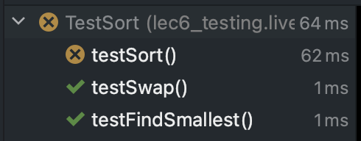
The Problem
Even after using our clever trick with the recursive helper method, our code is still not working:
What we know:
Sort’s helper methods have evidence of correctness from tests.
Sort method itself is very simple.
Notes:
35 total minutes
http://watchout4snakes.com/wo4snakes/Random/RandomPhrase

Slide 91
Using the Debugger to Fix Our Code
Let’s try to use the debugger (as seen in labs 2 and 3).
IMPORTANT IDEA: Let’s find the moment when reality diverges from expectation.
Don’t just step through the code hoping to see something weird.
Notes:
35 total minutes
http://watchout4snakes.com/wo4snakes/Random/RandomPhrase

Slide 92
Coding Demo
Sort.java
public class Sort {
public static void sort(String[] x) {
sort(x, 0);
}
/** Sorts the array starting at index start. */
private static void sort(String[] x, int start) {
if (start == x.length) {
return;
}
int smallest = findSmallest(x);
swap(x, start, smallest);
sort(x, start + 1);
}
}

Slide 93
Coding Demo
Sort.java
public class Sort {
public static void sort(String[] x) {
sort(x, 0);
}
/** Sorts the array starting at index start. */
private static void sort(String[] x, int start) {
if (start == x.length) {
return;
}
int smallest = findSmallest(x);
swap(x, start, smallest);
sort(x, start + 1);
}
}
// start: {"rawr", "a", "zaza", "newway"}

Slide 94
Coding Demo
Sort.java
public class Sort {
public static void sort(String[] x) {
sort(x, 0);
}
/** Sorts the array starting at index start. */
private static void sort(String[] x, int start) {
if (start == x.length) {
return;
}
int smallest = findSmallest(x);
swap(x, start, smallest);
sort(x, start + 1);
}
}
// start: {"rawr", "a", "zaza", "newway"}
// after 1 swap: {"a", "rawr", "zaza", "newway"}

Slide 95
Coding Demo
Sort.java
public class Sort {
public static void sort(String[] x) {
sort(x, 0);
}
/** Sorts the array starting at index start. */
private static void sort(String[] x, int start) {
if (start == x.length) {
return;
}
int smallest = findSmallest(x);
swap(x, start, smallest);
sort(x, start + 1);
}
}
// start: {"rawr", "a", "zaza", "newway"}
// after 1 swap: {"a", "rawr", "zaza", "newway"}
// after 2 swaps: {"a", "newway", "zaza", "rawr"}

Slide 96
Coding Demo
Sort.java
public class Sort {
public static void sort(String[] x) {
sort(x, 0);
}
/** Sorts the array starting at index start. */
private static void sort(String[] x, int start) {
if (start == x.length) {
return;
}
int smallest = findSmallest(x);
swap(x, start, smallest);
sort(x, start + 1);
}
}
// start: {"rawr", "a", "zaza", "newway"}
// after 1 swap: {"a", "rawr", "zaza", "newway"}
// after 2 swaps: {"a", "newway", "zaza", "rawr"}
// but we got: {"rawr", "a", "zaza", "newway"}

Slide 97
Major Design Flaw in findSmallest
Debugger showed us that we didn’t properly account for how findSmallest would be used.
Example: Want to find smallest item from among the last 4:
We need another parameter so that findSmallest is useful for sorting.
1
2
7
*
3
8
6
Notes:
35 total minutes
http://watchout4snakes.com/wo4snakes/Random/RandomPhrase

Slide 98
Progress Roadmap
Created testSort:
Created a sort skeleton:
Created testFindSmallest:
Created findSmallest:
Created testSwap:
Created swap:
Changed findSmallest:
Added helper method:
Used debugger to identify another fundamental design flaw in findSmallest.
Let’s try to fix it.
testSort()
Used Google to figure out how to compare strings.
sort(String[] inputs)
testFindSmallest()
String findSmallest(String[] input)
testSwap()
Used debugger to fix.
swap(String[] input, int a, int b)
int findSmallest(String[] input)
sort(String[] inputs, int k)

Slide 99
Coding Demo
TestSort.java
public class TestSort {
@Test
public void testFindSmallest() {
String[] input = {"rawr", "a", "zaza", "newway"};
int expected = 1;
int actual = Sort.findSmallest(input);
assertThat(actual).isEqualTo(expected);
}
}

Slide 100
Coding Demo
TestSort.java
public class TestSort {
@Test
public void testFindSmallest() {
String[] input = {"rawr", "a", "zaza", "newway"};
int expected = 1;
int actual = Sort.findSmallest(input, 0);
assertThat(actual).isEqualTo(expected);
}
}

Slide 101
Coding Demo
TestSort.java
public class TestSort {
@Test
public void testFindSmallest() {
String[] input = {"rawr", "a", "zaza", "newway"};
int expected = 1;
int actual = Sort.findSmallest(input, 0);
assertThat(actual).isEqualTo(expected);
expected = 1;
actual = Sort.findSmallest(input, 0);
assertThat(actual).isEqualTo(expected);
}
}

Slide 102
Coding Demo
TestSort.java
public class TestSort {
@Test
public void testFindSmallest() {
String[] input = {"rawr", "a", "zaza", "newway"};
int expected = 1;
int actual = Sort.findSmallest(input, 0);
assertThat(actual).isEqualTo(expected);
expected = 3;
actual = Sort.findSmallest(input, 2);
assertThat(actual).isEqualTo(expected);
}
}

Slide 103
Coding Demo
Sort.java
public class Sort {
/** @source https://stackoverflow.com/questions/5153496 */
public static int findSmallest(String[] x) {
int smallest = 0;
for (int i = 0; i < x.length; i += 1) {
int cmp = x[i].compareTo(x[smallest]);
if (cmp < 0) {
smallest = i;
}
}
return smallest;
}
}

Slide 104
Coding Demo
Sort.java
public class Sort {
/** @source https://stackoverflow.com/questions/5153496 */
public static int findSmallest(String[] x, int start) {
int smallest = 0;
for (int i = 0; i < x.length; i += 1) {
int cmp = x[i].compareTo(x[smallest]);
if (cmp < 0) {
smallest = i;
}
}
return smallest;
}
}

Slide 105
Coding Demo
Sort.java
public class Sort {
/** @source https://stackoverflow.com/questions/5153496 */
public static int findSmallest(String[] x, int start) {
int smallest = start;
for (int i = 0; i < x.length; i += 1) {
int cmp = x[i].compareTo(x[smallest]);
if (cmp < 0) {
smallest = i;
}
}
return smallest;
}
}

Slide 106
Coding Demo
Sort.java
public class Sort {
/** @source https://stackoverflow.com/questions/5153496 */
public static int findSmallest(String[] x, int start) {
int smallest = start;
for (int i = start; i < x.length; i += 1) {
int cmp = x[i].compareTo(x[smallest]);
if (cmp < 0) {
smallest = i;
}
}
return smallest;
}
}

Slide 107
Coding Demo
Sort.java
public class Sort {
public static void sort(String[] x) {
sort(x, 0);
}
/** Sorts the array starting at index start. */
private static void sort(String[] x, int start) {
if (start == x.length) {
return;
}
int smallest = findSmallest(x);
swap(x, start, smallest);
sort(x, start + 1);
}
}

Slide 108
Coding Demo
Sort.java
public class Sort {
public static void sort(String[] x) {
sort(x, 0);
}
/** Sorts the array starting at index start. */
private static void sort(String[] x, int start) {
if (start == x.length) {
return;
}
int smallest = findSmallest(x, start);
swap(x, start, smallest);
sort(x, start + 1);
}
}

Slide 109
Progress Roadmap
Created testSort:
Created a sort skeleton:
Created testFindSmallest:
Created findSmallest:
Created testSwap:
Created swap:
Changed findSmallest:
Added helper method:
Used debugger to identify another fundamental design flaw in findSmallest.
Modified findSmallest:
testSort()
Used Google to figure out how to compare strings.
sort(String[] inputs)
testFindSmallest()
String findSmallest(String[] input)
testSwap()
Used debugger to fix.
swap(String[] input, int a, int b)
int findSmallest(String[] input)
sort(String[] inputs, int k)
int findSmallest(String[] input, int k)
Notes:
20 minutes to get here going slow.

Slide 110
And We’re Done!
Often, development is an incremental process that involves lots of task switching and on the fly design modification.
Tests provide stability and scaffolding.
Provide confidence in basic units.
Ensure that later changes to basic units don’t break them.
All individual pieces of your code are under constant inspection, not just the overall program.
Help you focus on one task at a time.
In larger projects, tests also allow you to safely refactor! Sometimes code gets ugly, necessitating redesign and rewrites (see projects 2B and 3).

Slide 111
Testing Philosophy
A New Way
Intro to Unit Testing
Ad-Hoc Tests are Tedious
Unit Testing Frameworks, Truth
Building Selection Sort
The Selection Sort Algorithm
Find Smallest
Swap
Correcting a Design Error
Figuring out the Recursion
Fixing Another Design Error
Testing Philosophy
Lecture 6, CS61B, Spring 2024

Slide 112
Correctness Tool #1: Autograder
Idea: Magic autograder tells you code works.
Behind the scenes, we use Truth + JUnit + jh61b libraries.
Downsides:
Don’t exist in the real world.
Very slow workflow.
Autograder
sort

Slide 113
Autograder Driven Development (ADD)
The worst way to approach programming in 61B:
Write entire program.
Send to autograder. Get many errors.
Until correct, repeat:
Run autograder.
Add print statements to find bug.
[63, 12, 91, 5, 0]
got to this spot, lt is: 1
got to this spot, lt is: 2
got here!
[63, 12, 0, 5, 91]
got to this spot, lt is: 3
got to this spot, lt is: 4
got here!
[5, 12, 0, 63, 91]
Test Failed. Expected: ...
Make changes to code to try to fix bug.
This workflow is slow and unsafe!
Note: Print statements are not inherently evil. While they are a weak tool, they are very easy to use.

Slide 114
Correctness Tool #2: Unit Tests
Idea: Write tests for every “unit”.
Truth (and assertJ and JUnit) make this easy!
testSort
More up front investment.
Saves you time in the long run!
sort
swap
findSmallest
testSwap
testFindSmallest
Notes:
11 minutes showing good way to test, not including this slide.

Slide 115
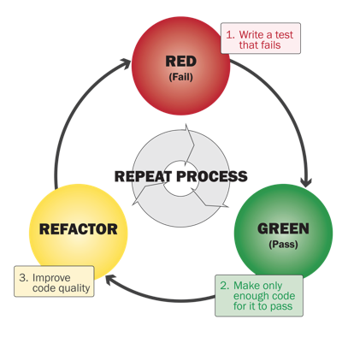
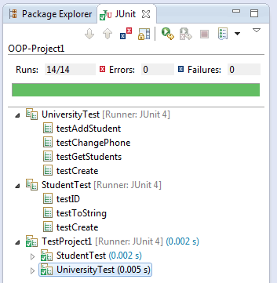
Test-Driven Development (TDD)
Steps to developing according to TDD:
Identify a new feature.
Write a unit test for that feature.
Run the test. It should fail. (RED)
Write code that passes test. (GREEN)
Implementation is certifiably good!
Optional: Refactor code to make it faster, cleaner, etc.
Not required in 61B. You might hate this!
Even if you don’t use TDD, testing is a good idea.
Interesting perspective: Red-Shirt, Red, Green, Refactor.

Slide 116
A Tale of Two Workflows
TDD is the opposite of the autograder-with-print-statements workflow.
What’s best for you is probably in the middle.
$ python sort.py
[63, 12, 91, 5, 0]
got to this spot, lt is: 1
got to this spot, lt is: 2
got here!
[63, 12, 0, 5, 91]
got to this spot, lt is: 3
got to this spot, lt is: 4
got here!
[5, 12, 0, 63, 91]
Notes:
http://ryantablada.com/post/red-green-refactor---a-tdd-fairytale

Slide 117

Correctness Tool #3: Integration Testing
Idea: Tests cover interaction of all units at once.
As seen in project 0.
addFirst
addLast
Why? Unit testing is often not enough to ensure modules interact properly or that system works as expected.
We won’t have you build full scale integration tests in our class.
size
isEmpty
...
...
ArrayDeque
Some sort of script in Java, Python, etc.
Automatic
Manual
Notes:
https://thumbs.dreamstime.com/x/business-person-eating-pizza-computer-8427611.jpg

Slide 118
Extra Slides: How Unit Tests are Run

Slide 119
Bonus Slide: What is an Annotation?
Annotations (like @Test) don’t do anything on their own.
Runner uses reflections library to iterate through all methods with “Test” annotation. Pseudocode on next slide.
@Test
public void testSort() {
...
}

Slide 120
Sample Runner Pseudocode
Runner uses reflections library to iterate through all methods with “Test” annotation.
List<Method> L = getMethodsWithAnnotation(TestSort.class,
@Test);
int numTests = L.size();
int numPassed = 0;
for (Method m : L) {
result r = m.execute();
if (r.passed == true) { numPassed += 1; }
if (r.passed == false) { System.out.println(r.message); }
}
System.out.println(numPassed + “/” + numTests + “ passed!”);

Slide 121

How It Usually Goes...
Autograder
public static void sort(String[] inputs)
Notes:
https://www.fluffybooru.org/post/view/40111

